Slide 1
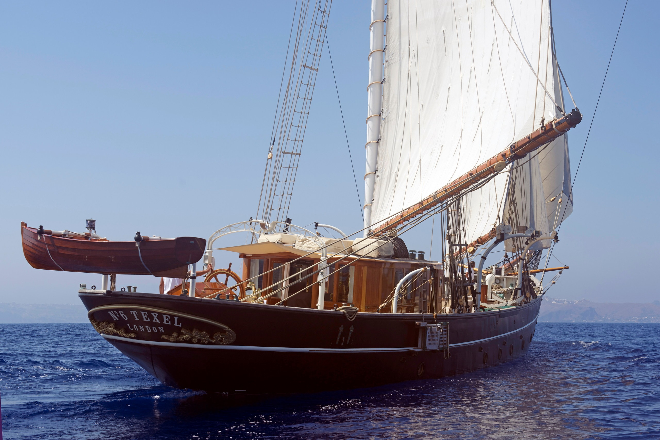
Marine Underwriting Demo Analysis
By: Robin M.

Slide 2
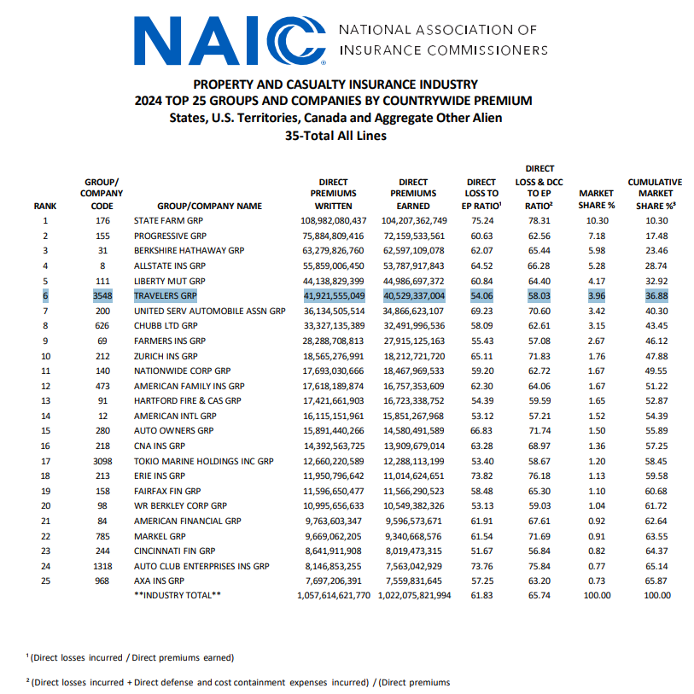
Background
The Direct Loss to EP ratio at Travelers according to the NAIC was 54% in 2024.
The Marine Loss Ratio for the sample 500 policies of this year are at 80%.
This indicates that an underwriting strategy should be implemented.

Slide 3
Background
Utilizing AI technology and industry knowledge of marine insurance, I created a mock set of data for 500 policies in a year throughout the US region.
With prompt engineering, I specified how I wanted every column of data to be generated, such as hull types, locations, and generating purchase price values based off of Yachtworld.com.
After the data was generated, data cleaning steps were taken to remove junk data and then it was further reorganized. AI is a beneficial tool, but the results must be monitored and reviewed before any analysis.

Slide 4
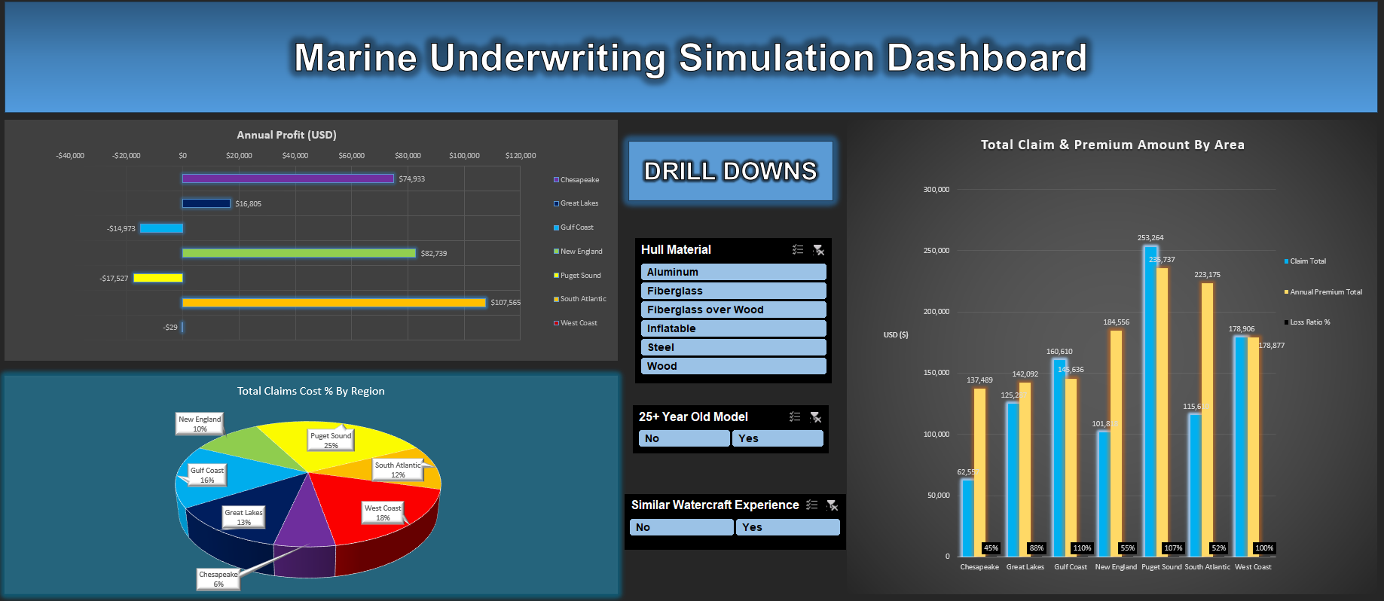
Using the mock data, I built a dynamic Excel dashboard that simulates how changes in underwriting rules affect overall profit, regional profit and the overall loss ratio given various sensitivity analysis.

Slide 5
KPIs from Mock Data:
Total Annual Claims Cost: $998,050
Total Annual Earned Premium*: $1,247,563
Loss Ratio 2024: 80%
# of Marine Claims 2023: 215
Exposure Sample Size: 500 Policies
*All Written Premium is assumed as Earned Premium in this model.

Slide 6
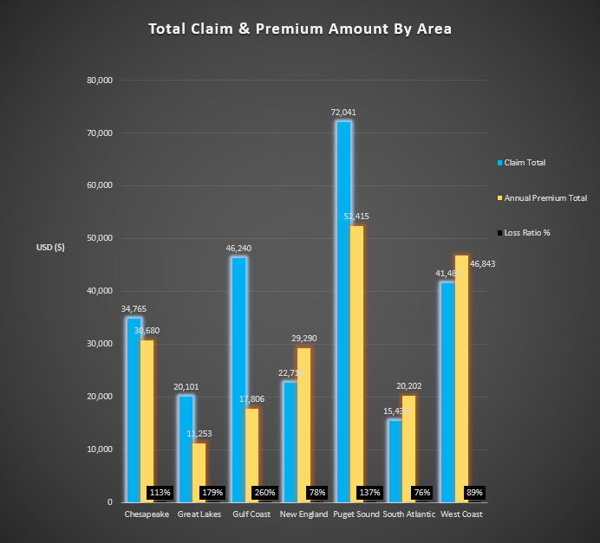
Key Findings
Implementing more stringent underwriting rules regarding previous watercraft operator experience could reduce losses across all regions.
Most notably the Gulf Coast region had a 260% Loss Ratio if only policies without similar operator experience were analyzed. Compared to the 110% Loss Ratio aggregate for the Gulf Coast this year.
Loss Ratio, given as a % at the bottom, for polices where operators DID NOT have similar size boating experience

Slide 7
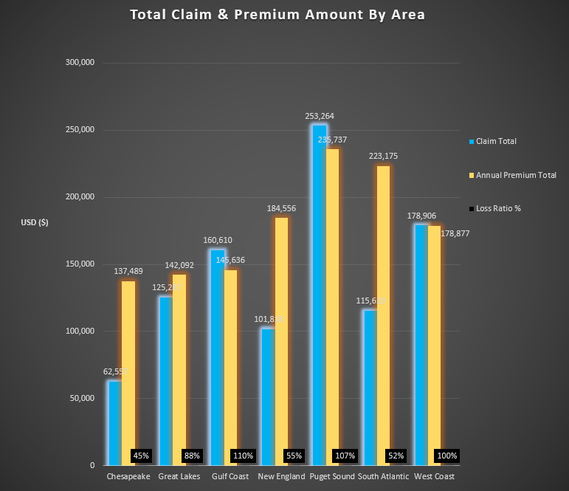
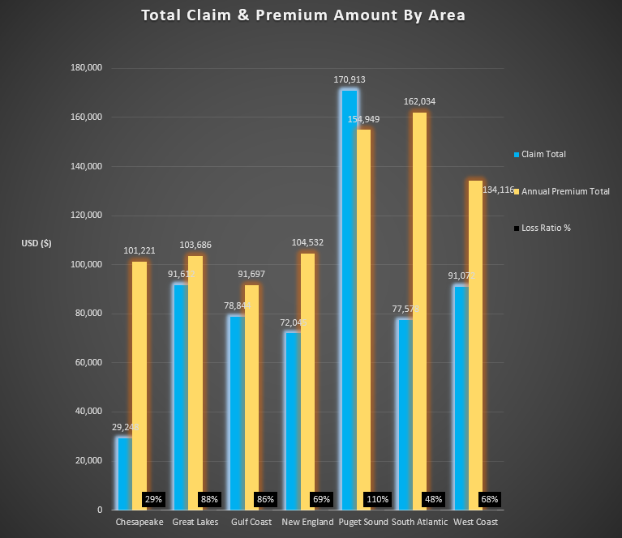
Aggregate for this year
Claim & Premium if only younger boats were considered
Shifting appetite away from yachts 25 years and older reduces loss ratios in key coastal regions by over 24%.

Slide 8
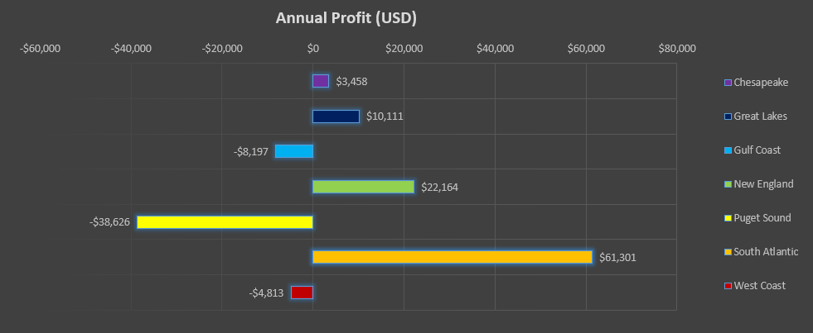
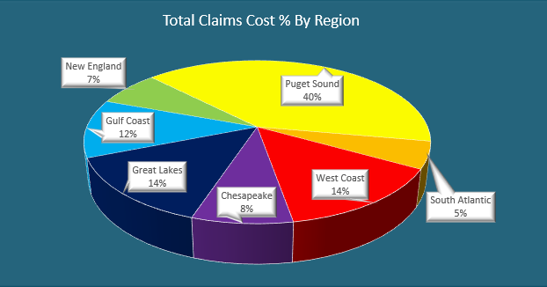
Fiberglass over Wood Policy Data
A regional consideration to the Puget Sound should be given for hull types of fiberglass over wood. Marine Vessels with this hull type had a 232% Loss Ratio, a striking anomaly.

Slide 9
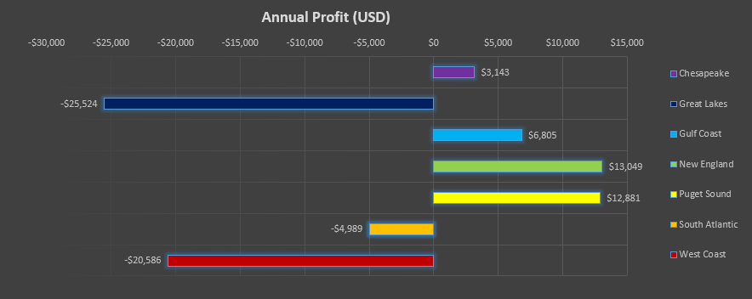
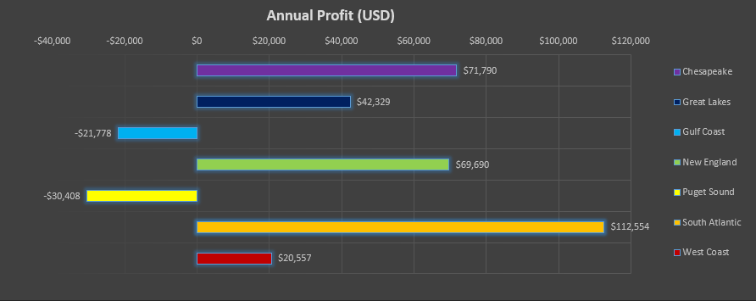
Profit from Policies with Wood Hulls
Profit from Policies without Wood Hulls
Wood hulls generate massive losses in the Great Lakes, South Atlantic, and West Coast regions.
The Gulf Coast appears to do better with wood hulls at first glance however it should be noted there are ONLY 15 policies with wood hulls in this region.

Slide 10
Underwriting Strategy Takeaways
Underwrite vessels only if the operator has similar boating experience
Avoid boats 25 years and older
Avoid insuring vessels with wood hulls

Slide 11
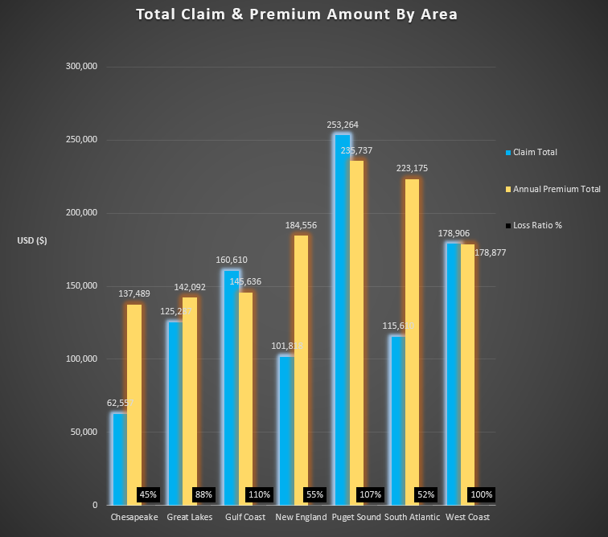
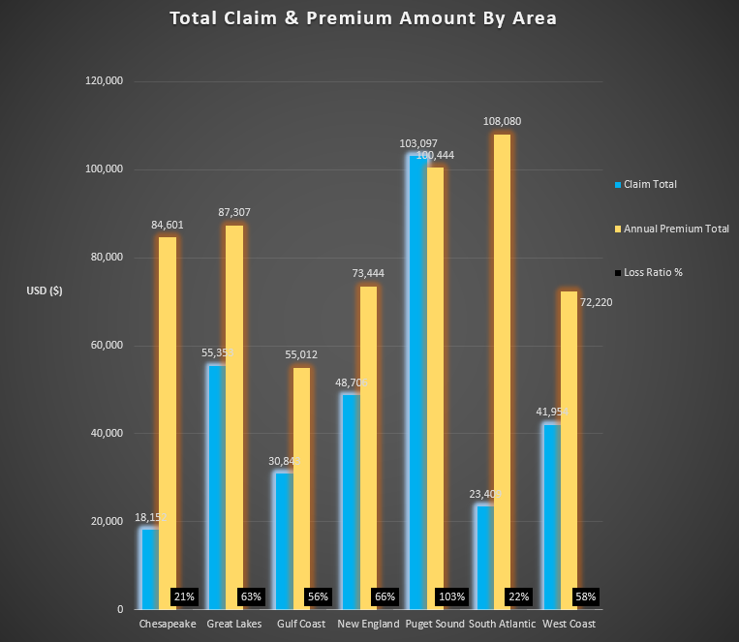
Actual Claim and Premium Amount 2024
What Claim and Premium Amount Would look like if suggested underwriting strategy was implemented in 2024

Slide 12
Key Takeaways
With these underwriting strategies taken under consideration, we would have went from a Loss Ratio of 80% → A Loss Ratio of 55%.
That 55% Loss Ratio for Marine Vessels is approximately in line with Travelers Direct Loss to EP Ratio for 2024 according to the NAIC .
This underwriting strategy should be implemented for the 2025 fiscal year, and monitored for improved trends and performances
The Puget Sound should be further investigated in relation to its Fiberglass over Wood claims. Was that trend specific to 2024, or perhaps with more data a more regular trend can be established and we can adjust underwriting appetite accordingly.

Slide 13
Sources
Boat Image Background:
https://www.autoevolution.com/news/1920-classic-yacht-previously-owned-by-royalty-is-a-2-million-piece-of-history-199356.html
NAIC Data:
https://content.naic.org/sites/default/files/research-actuarial-property-casualty-market-share.pdf

